Slide 1
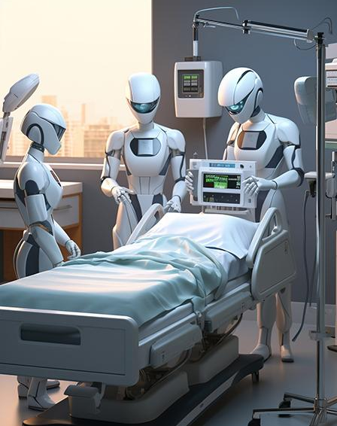
Machine Learning Applications in Medicine
A Look into the future of Medicine

Slide 2
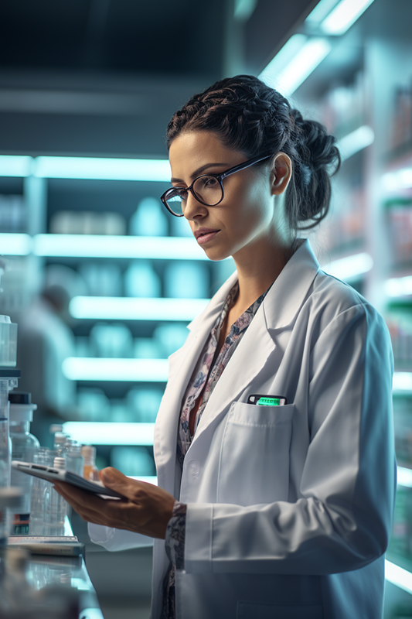
INTRODUCTION
To discuss the importance of Machine Learning in the medicine field each field has been studied individually, So first we need to do is to have a little background about both fields.

Slide 3
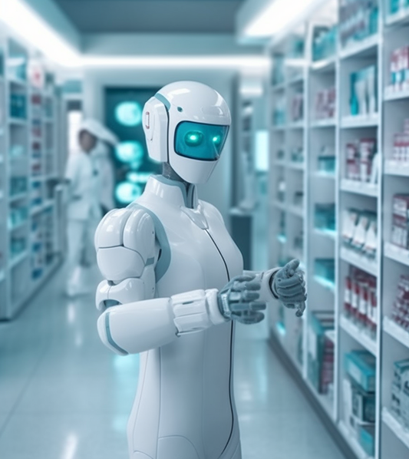
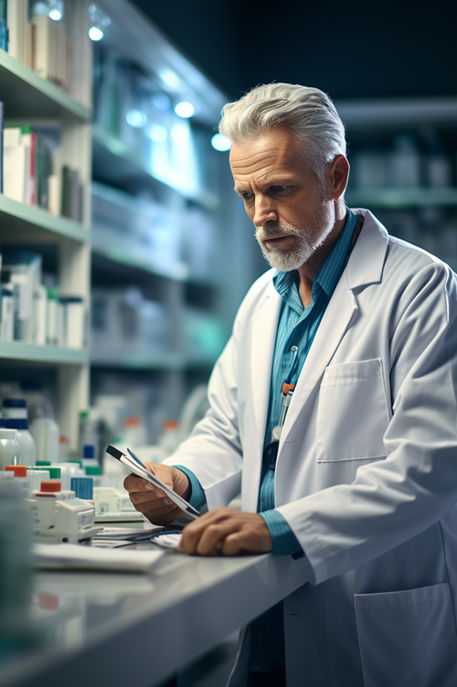
Machine Learning
Medicine
machine learning have different algorithms that are trained to make predictions or classifications and to find valuable information in data mining projects using statistical techniques. Subsequently, these insights inform business and application decisions
medicine field it’s known for a general sense but in more details the study of health and healing is known as medicine. It consists of physicians, nurses, and other specialists. It covers a wide range of topics related to health, including medical research, disease diagnosis, treatment, and so on.

Slide 4
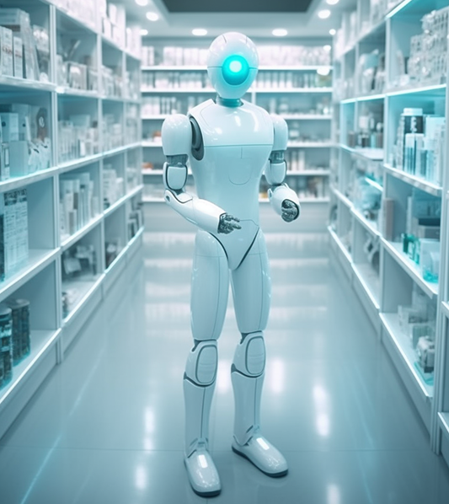
The two fields being intertwined have not only impacted the development of the medicine alone but also the machine learning and artificial intelligence.

Slide 5
Applications of machine learning
Identifying Diseases and Diagnosis
comparing a patient's symptoms, genetic history, demographics, and other data with the data of other patients in the system, medical professionals used machine learning to ascertain whether a patient has a disease or another.
Decision Tree
KNN
Medical Imaging Diagnosis
which develops image diagnostic tools for image analysis. Anticipate the inclusion of more data sources from various medical imagery types in this AI-driven diagnostic process as machine learning grows in accessibility and explanatory power.
CNN

Slide 6
Applications of machine learning
Drug Discovery and Manufacturing
This also includes research and development technologies that can aid in the discovery of alternate avenues for the treatment of multifactorial diseases, such as precision medicine and next-generation sequencing.
SVM
Clinical Trial and Research
machine learning has been applied to determine the ideal test sample size, guarantee real-time monitoring and data access for trial participants.
Logistic regression
Random Forest

Slide 7
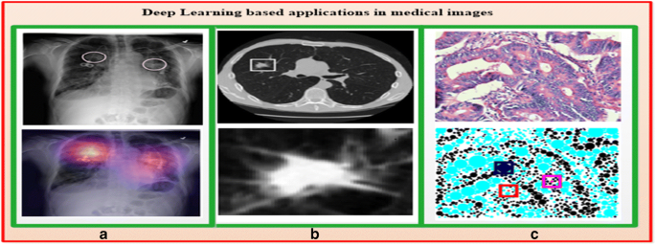
Applications of machine learning
Radiotherapy
It gets simpler to diagnose and identify the variables because ML-based algorithms learn from the vast array of available samples. The most widely used application of machine learning in medical image analysis is the classification of objects, like lesions, into normal and abnormal.
Ensemble methods
Bayesian Networks

Slide 8
Challenges
lack of quality data
It’s hard to determine if complex model is preferable to a simpler model due to the lack of transparency.
Models are regarded as intellectual property by medical facilities and related software these opaque problems lead to code duplication amongst organizations and complicate the process.

Slide 9
Conclusion
There are certain difficulties in applying machine learning to medical data as we discussed but understanding the issues of the data and models can help further achieve the aim of using machine learning in medicine which is greater effect with lower cost, as we have seen progressively.

Slide 10
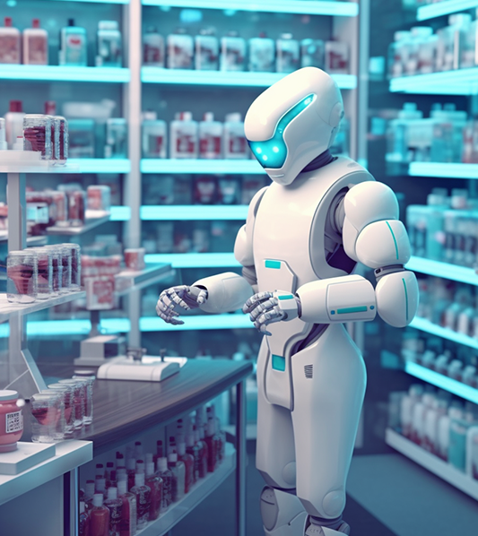
THANKS!
Name: Ghazal Helal
Course : Machine Learning

